Slide 1
Lights, Data, Action!
Intro to Data Science and ML in Python
✨
🎥
Christopher Perez
CS50 Seminar Fall 2024

Slide 2
Outline ✅
What is data science?
What is machine learning?
Interactive example with real dataset
Looking ahead: resources and next steps
Notes:
mention the following: who is this seminar for? the purpose of this seminar

Slide 3
Data Science 📊

Slide 4
Data Science 📊
The process of gathering, analyzing, and interpreting data to uncover patterns, make informed decisions, and predict future outcomes.
A multidisciplinary field that combines statistics, data analysis, and machine learning.
Lots of real-world applications! Route optimization, revenue forecasting, election forecasting, etc…
Notes:
Data Science impacts nearly every area where data exists, from consumer goods and logistics to stock markets and e-commerce.

Slide 5
Typical Data Science Workflow 🔄
Define the problem
Data collection
Data cleaning and preparation
Exploratory data analysis (EDA)
Feature engineering
Model development
Model evaluation
Deployment
Monitoring and iteration

Slide 6
Machine Learning 🤖

Slide 7
Machine Learning 🤖
Goal: Imitate the way that humans learn to gradually improve accuracy.
The application of statistical, mathematical, and numerical techniques to derive some form of knowledge from data.
Dependent on human intervention (e.g., determining the set of features, understanding data input)
Powers many innovative technologies used today: personalized recommendations (e.g., Netflix, Spotify), fraud detection in banking, predictive healthcare analysis)

Slide 8
Machine Learning 🤖
Machine Learning
Supervised Learning
Unsupervised Learning
Reinforcement Learning
Notes:
supervised learning: train model on labeled data, each input paired with correct output. goal is to learn a mapping from inputs (features) to outputs
unsupervised: model is given data without labels, goal: uncover hidden patterns or groupings within the data
reinforcement learning (RL): involves an agent learning to make decisions by interacting with an environment, rewards or penalties for actions and aims to maximize cumulative rewards over time

Slide 9
Machine Learning 🤖
Supervised Learning Overview
Machine Learning
Supervised Learning
Unsupervised Learning
Reinforcement Learning
Notes:
supervised learning: train model on labeled data, each input paired with correct output. goal is to learn a mapping from inputs (features) to outputs
unsupervised: model is given data without labels, goal: uncover hidden patterns or groupings within the data
reinforcement learning (RL): involves an agent learning to make decisions by interacting with an environment, rewards or penalties for actions and aims to maximize cumulative rewards over time

Slide 10
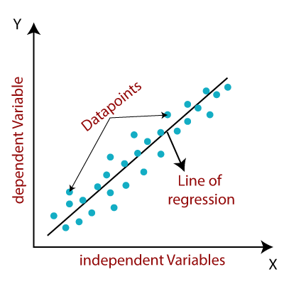
Machine Learning 🤖
Supervised Learning Methods
Regression
Machine Learning
Supervised Learning
Unsupervised Learning
Reinforcement Learning
goal: minimize least squares loss
Notes:
supervised learning: train model on labeled data, each input paired with correct output. goal is to learn a mapping from inputs (features) to outputs
unsupervised: model is given data without labels, goal: uncover hidden patterns or groupings within the data
reinforcement learning (RL): involves an agent learning to make decisions by interacting with an environment, rewards or penalties for actions and aims to maximize cumulative rewards over time

Slide 11
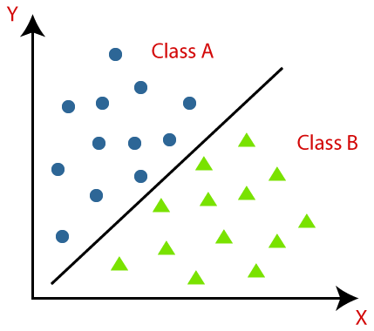
Machine Learning 🤖
Supervised Learning Methods
2) Classification
Machine Learning
Supervised Learning
Unsupervised Learning
Reinforcement Learning
goal: 0/1 loss
Notes:
supervised learning: train model on labeled data, each input paired with correct output. goal is to learn a mapping from inputs (features) to outputs
unsupervised: model is given data without labels, goal: uncover hidden patterns or groupings within the data
reinforcement learning (RL): involves an agent learning to make decisions by interacting with an environment, rewards or penalties for actions and aims to maximize cumulative rewards over time

Slide 12
Machine Learning 🤖
Unsupervised Learning Overview
Machine Learning
Supervised Learning
Unsupervised Learning
Reinforcement Learning
Notes:
supervised learning: train model on labeled data, each input paired with correct output. goal is to learn a mapping from inputs (features) to outputs
unsupervised: model is given data without labels, goal: uncover hidden patterns or groupings within the data
reinforcement learning (RL): involves an agent learning to make decisions by interacting with an environment, rewards or penalties for actions and aims to maximize cumulative rewards over time

Slide 13
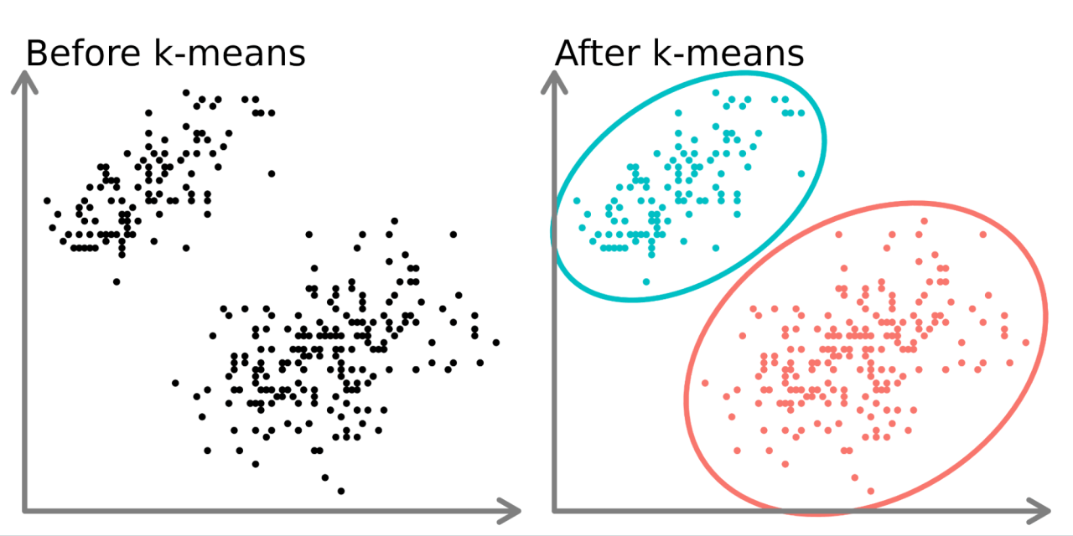
Machine Learning 🤖
Unsupervised Learning Methods
Clustering
Machine Learning
Supervised Learning
Unsupervised Learning
Reinforcement Learning
Notes:
supervised learning: train model on labeled data, each input paired with correct output. goal is to learn a mapping from inputs (features) to outputs
unsupervised: model is given data without labels, goal: uncover hidden patterns or groupings within the data
reinforcement learning (RL): involves an agent learning to make decisions by interacting with an environment, rewards or penalties for actions and aims to maximize cumulative rewards over time

Slide 14
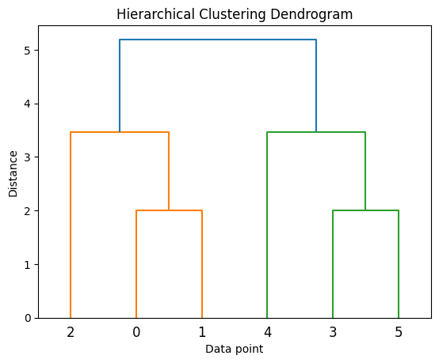
Machine Learning 🤖
Unsupervised Learning Methods
2) Hierarchical Agglomerative Clustering (HAC)
Machine Learning
Supervised Learning
Unsupervised Learning
Reinforcement Learning
Notes:
supervised learning: train model on labeled data, each input paired with correct output. goal is to learn a mapping from inputs (features) to outputs
unsupervised: model is given data without labels, goal: uncover hidden patterns or groupings within the data
reinforcement learning (RL): involves an agent learning to make decisions by interacting with an environment, rewards or penalties for actions and aims to maximize cumulative rewards over time

Slide 15

Machine Learning 🤖
Reinforcement Learning Overview
Machine Learning
Supervised Learning
Unsupervised Learning
Reinforcement Learning
Notes:
reinforcement learning (RL): involves an agent learning to make decisions by interacting with an environment, rewards or penalties for actions and aims to maximize cumulative rewards over time
Agent: The learner or decision-maker.
Environment: Everything the agent interacts with.
State (sss): A representation of the current situation in the environment.
Action (aaa): A decision the agent can make.
Reward (rrr): Feedback signal indicating the success of an action.
Policy (π\piπ): A strategy that maps states to actions.
Value Function (V(s)V(s)V(s)): Predicts long-term rewards from a given state.

Slide 16
Machine Learning 🤖
Reinforcement Learning Methods
1) Q-Learning
Machine Learning
Supervised Learning
Unsupervised Learning
Reinforcement Learning
Notes:
reinforcement learning (RL): involves an agent learning to make decisions by interacting with an environment, rewards or penalties for actions and aims to maximize cumulative rewards over time
Represents the expected cumulative reward of taking action aaa in state sss and following the optimal policy thereafter.
ind the optimal policy for an agent. It focuses on learning a Q-value function, which estimates the quality of actions in specific states.
Q-learning is a type of reinforcement learning that uses trial-and-error to teach an agent how to maximize the expected value of future rewards. The agent learns to estimate the value of each action in a given state, and then chooses the action with the highest value.
applications: self driving cars, automated robots, image processing

Slide 17
Hands-on Example 🎵
(Spotify Most Streamed Songs)

Slide 18
Looking ahead 🚀

Slide 19
Resources
Pandas Documentation
Official Docs: https://pandas.pydata.org/docs/
Learn how to manipulate and analyze data effectively
Scikit-Learn (sklearn) Documentation
Official Docs: https://scikit-learn.org/stable/user_guide.html
Explore tools for building and evaluating ML models
Weights and Biases (W&B) Documentation
Official Docs: https://docs.wandb.ai/
A platform to track, visualize, and optimize ML experiments
Interactive Learning Resources:
Kaggle Datasets and Tutorials: https://www.kaggle.com/

Slide 20
Thanks for Watching! 🎉

